Slide 1
Biology
Department of Life Science
NIT Rourkela

Slide 2
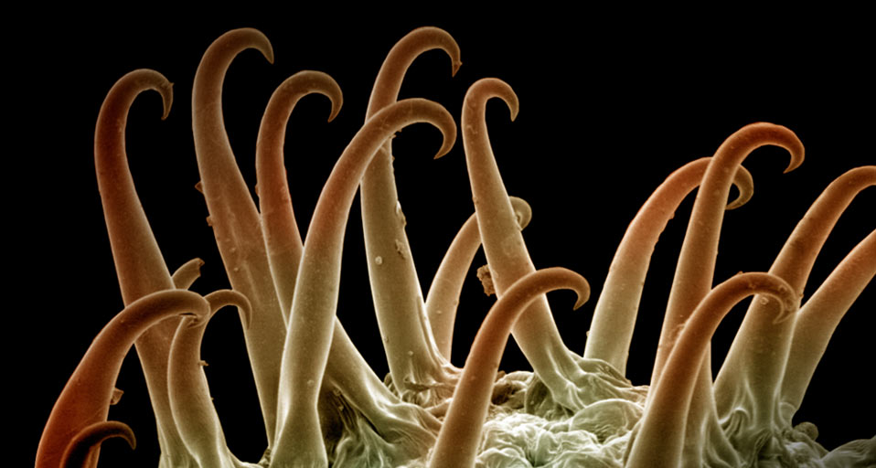
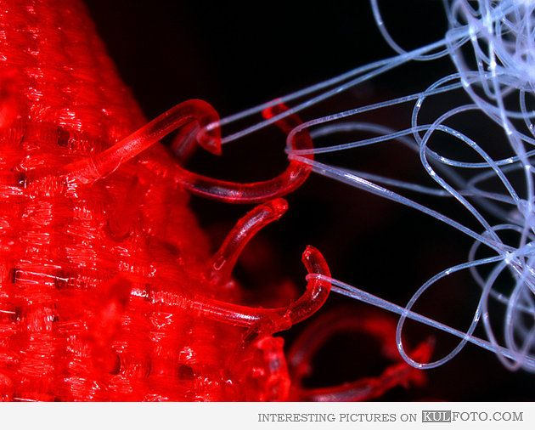
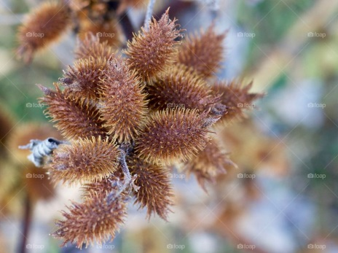
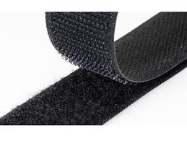
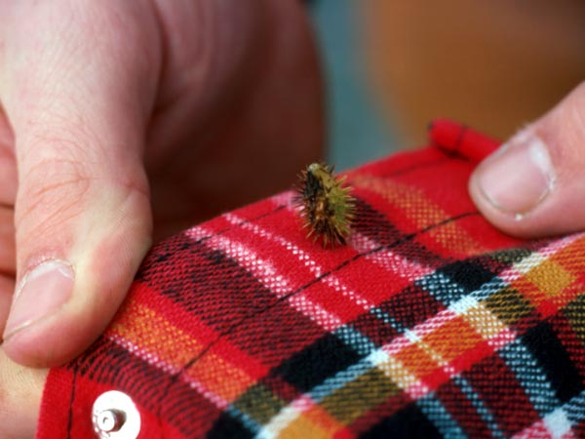
Velcro - Cockleburrs

Slide 3
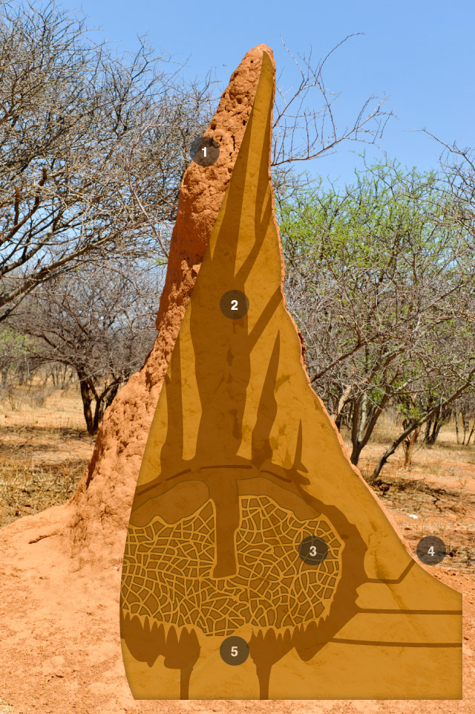
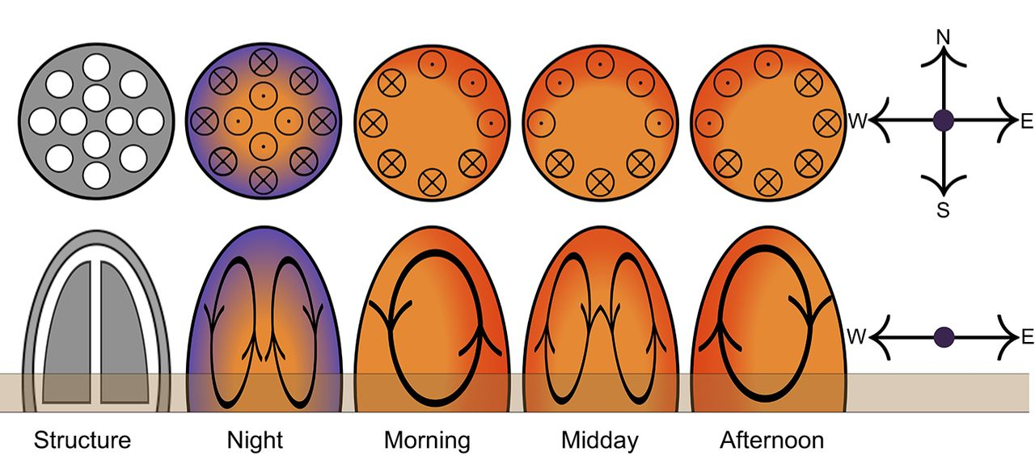
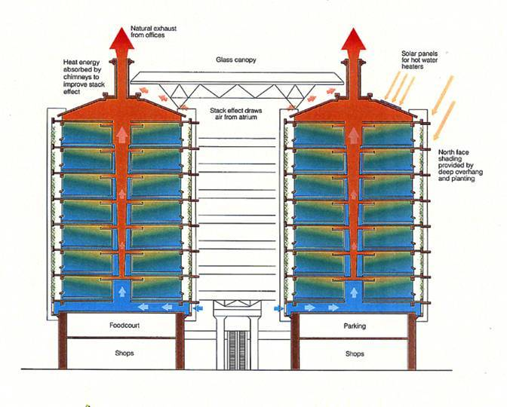
Ventilation (Air Conditioning) - Termite Mound

Slide 4
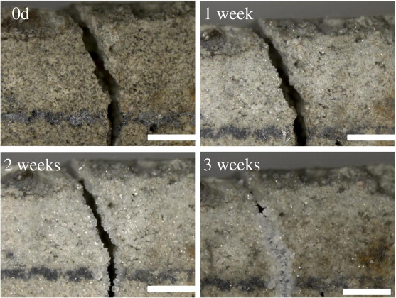
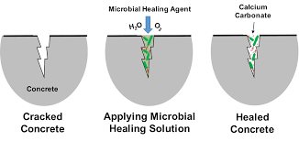
Self Healing Concrete – Microbes

Slide 5
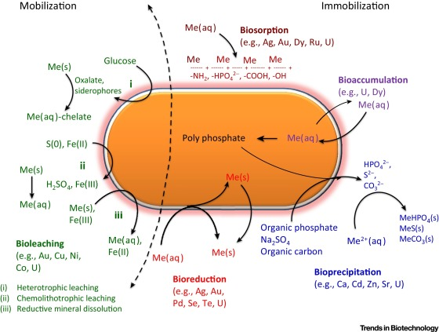
Biomining – Recovery of metals

Slide 7
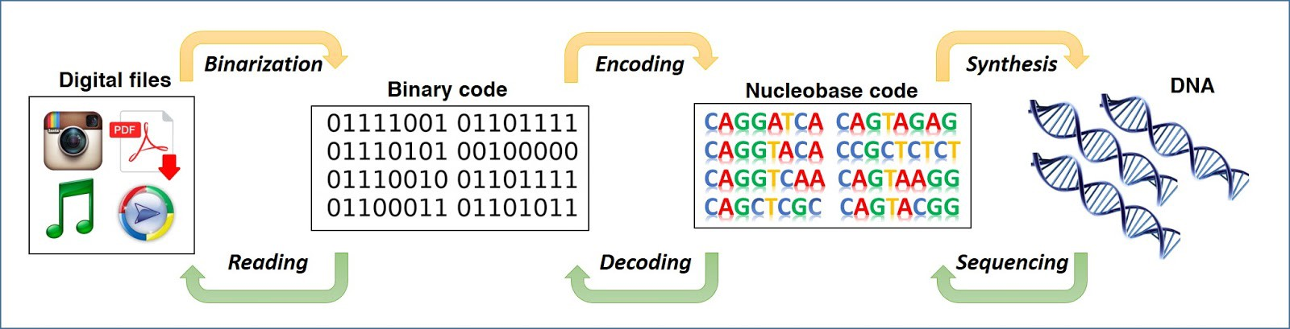
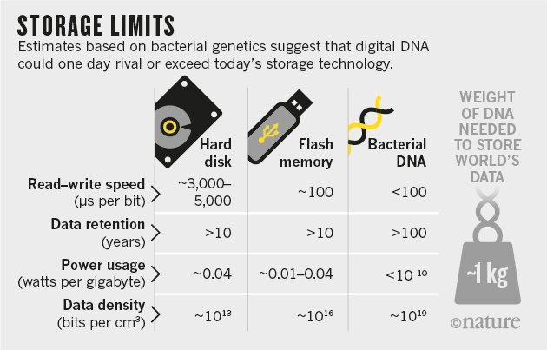
Data Storage

Slide 8
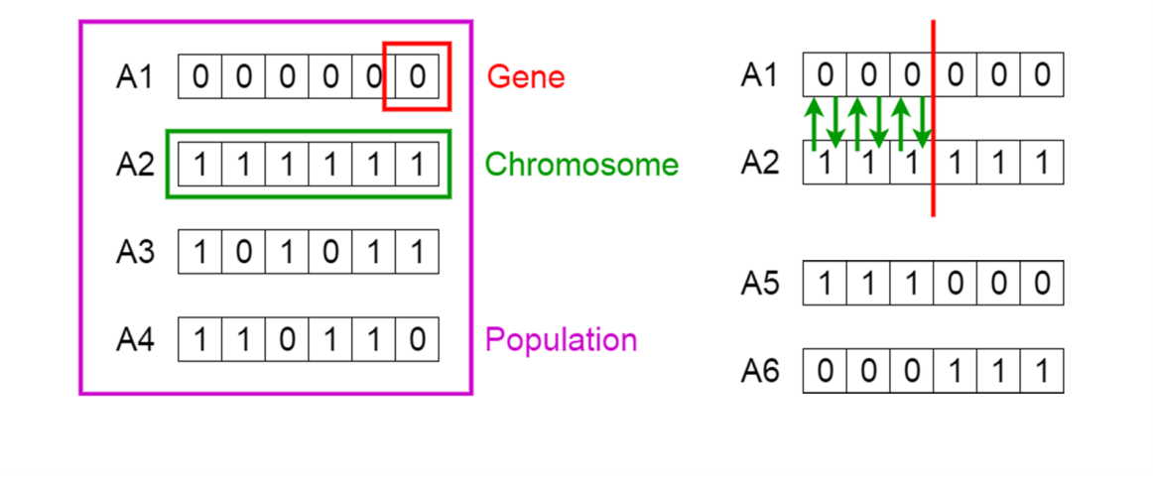
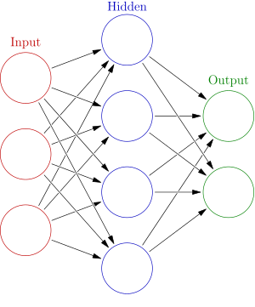
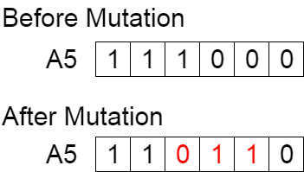
Machine learning algorithms
Neural networks
Genetic algorithm

Slide 9
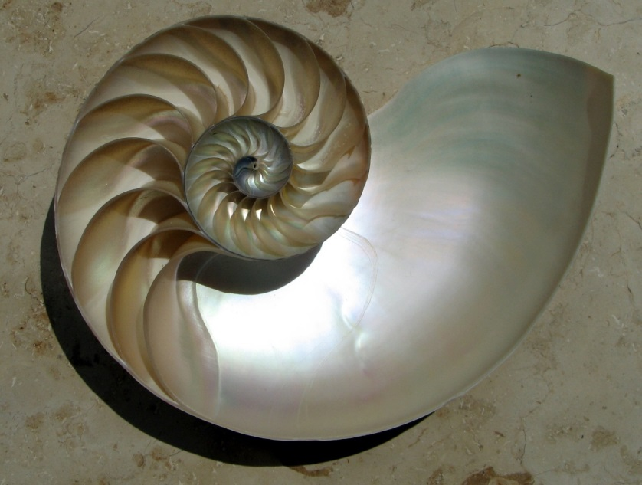
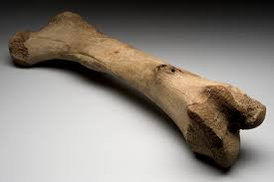
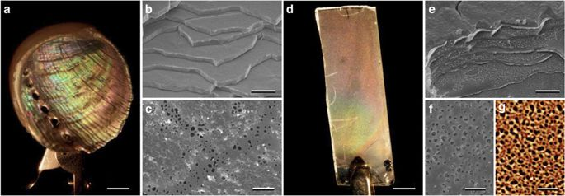
Ceramics – Biocermaics

Slide 10
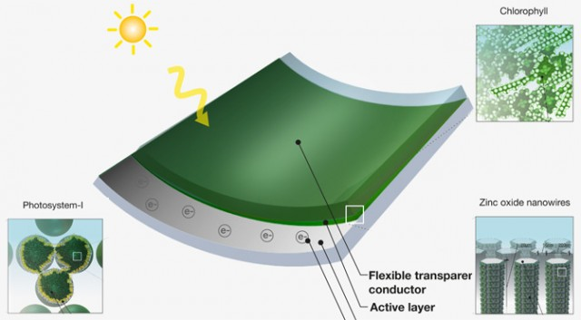
Chlorophyll based solar panels

Slide 11
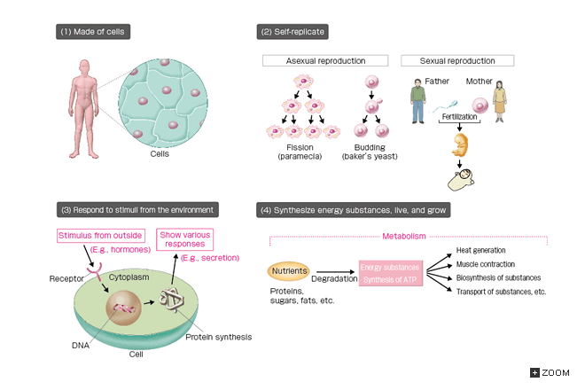
Organisms

Slide 12
Organism
Organism can be broadly defined as a molecule assembly functioning in totality and exhibits properties of life
Monomeric unit of their existence is called Cells
Basic parameters of an organism is its life span. Some organisms live for one day, while some plants and fungi can live thousands of years
Complex system of macromolecules and small molecules
Macromolecules like carbohydrates, proteins, nucleic acid and lipids play important role in day to day function of the organism

Slide 13
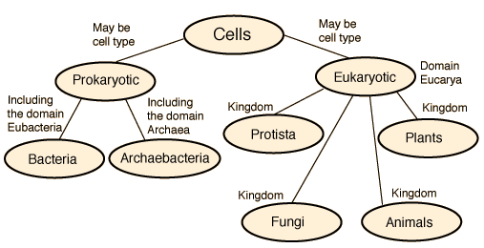
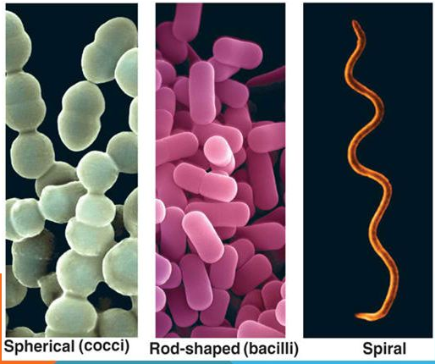
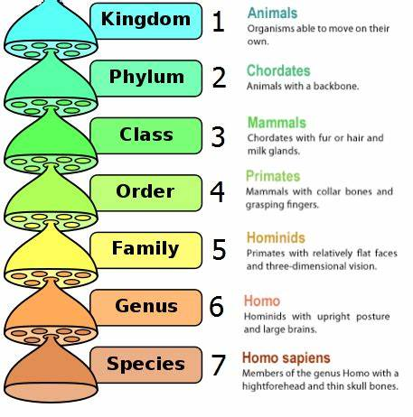
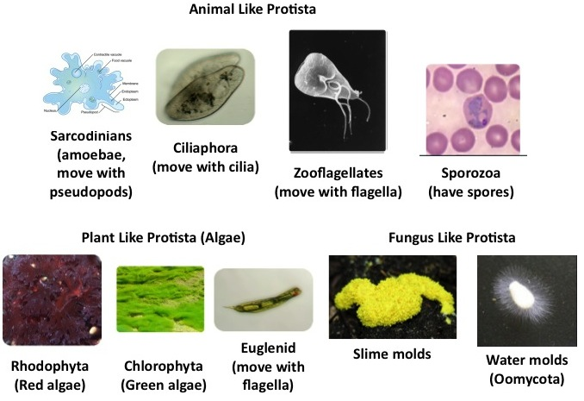
Five Kingdom Classification

Slide 14
Organism
Unicellular Multicellular
organism
Unicellular Organisms
Known as a single-celled organism
Main groups of unicellular organisms are bacteria, archaea, protozoa, algae
and fungi
Fall into two general categories: prokaryotic and eukaryotic organisms
Oldest form of life, possibly existing 3.8 billion years ago
Mostly these organisms are microscopic and categorised as microorganisms
Examples are: Bacteria like Escherichia coli, Mycobacteria, Bacillus etc.
Protozoans like Amoeba, Paramecium etc. Algae like Acetabularia etc.

Slide 15
Multicellular Organisms
Consist of many cells specialized to do different functions for maintaining the complexity of the organism.
Most bacteria are unicellular, but some bacterial species are multicellular like Myxobacteria. Some species of cyanobacteria are also multicellular like Chara, Spirogyra etc.
Most eukaryotic organism are multicellular. Multicellular organisms have well developed body structure and have specific organs for specific function.
Most well-developed plants and animals are multicellular. All animals are eukaryotic in nature and most of them are multicellular. In plants highly evolved types like angiosperms and gymnosperms are multicellular.
Cell divisions is essential for three major functions in multicellular organisms: growth, development, and repair
Two types of divisions are present: Mitosis (vegetative divisions) and Meiosis (Reductive Cell division)

Slide 16
Unicellular vs Multicellular
Unicellular organism | Multicellular organism
Body is made up of single cell | Body is made up of numerous cells
Division of labour is at the organelle level. It gives a low level of operational efficiency | Division of labour may be at cellular, tissue, organ and organ system level. It gives high degree of operational efficiency
A single cell carries out all the life processes | Different cells are specialized to perform different functions
The cell body is exposed to the environment on all sides | Only outer cells are specialized to face the environment. Inner cells are devoted to other functions

Slide 17
Unicellular vs Multicellular
An injury of the cells can cause death of the organism. | Injury or death of some cells does not affect the organisms as the same can be replaced by new one.
A cell body cannot attain a large size because of the limit imposed by surface area to volume ratio | A multicellular body can attain a large size increasing the number of small cells
Lifespan is short due to heavy load of work | Lifespan is long due to limited load of work for each cell type
Power of division is not lost | Certain specialized cells lose power of division
A well-marked capacity of regeneration is present | The capacity of regeneration decreases with increasing specialization
The cell has the same role for itself and the organism | Cells have a double role. One for themselves and other for the organism

Slide 18
Cell Theory
Cell is a basic structural, functional and biological unit of all living organisms (Unicellular and multicellular)
Term originated from Latin Word “Cella” meaning small room

Slide 19
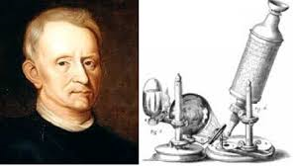
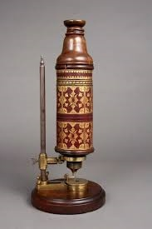
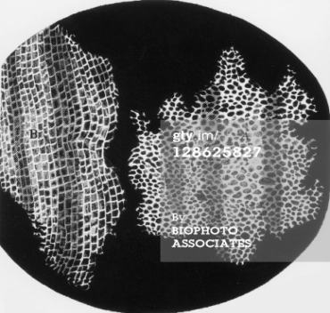
Cell theory – Robert Hook (1665)
Published findings about Cells in his book entitled “Micrographia” in which he gave 60 ‘observations of various objects under a coarse, compound microscope
Hooke did not know their real structure or function
He had thought that cells were actually empty cell walls of plant tissues
With microscopes of low magnification at that time, Hooke was unable to see internal components of the cells he was observing
So he thought cells were dead and his observations gave no indication of the nucleus and other organelles found in most living cells
Robert Hooke Microscope Cells of Cork

Slide 20
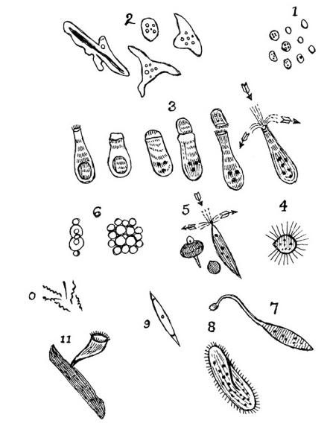
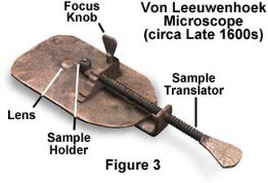
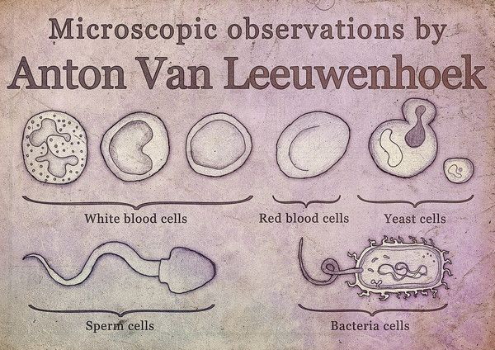
Cell theory – Anton van Leeuwenhoek
He made use of a microscope containing improved lenses that could magnify objects almost 300-fold
Under these microscopes, Leeuwenhoek found motile objects and he states that motility is a quality of life therefore these were living organisms

Slide 21
Cell theory – Anton van Leeuwenhoek
Over time, he wrote many more papers in which described many specific forms of microorganisms like bacteria and protozoa
The cells in animal tissues were observed after plants because the tissues were so fragile and susceptible to tearing, it was difficult for such thin slices to be prepared for studying
Biologists believed that there was a fundamental unit to life, but were unsure what this was
It would not be until over a hundred years later that this fundamental unit was connected to cellular structure and existence of cells in animals or plants

Slide 22
Cell theory
This conclusion was not made until Henri Dutrochet who besides stating, “the cell is the fundamental element of organization”, also claimed that cells were not just a structural unit, but also a physiological unit
In 1804, Karl Rudolphi and J.H.F. Link were awarded the prize for "solving the problem of the nature of cells", meaning they were the first to prove that cells had independent cell walls, by the Königliche Societät der Wissenschaft (Royal Society of Science), Göttingen
Later in 1838 concept of cell theory came into existence

Slide 23
Cell Theory
In biology, cell theory is a scientific theory which describes the properties of cells
Cell theory is the foundation of biology and is the most widely accepted explanation of the function of cells
After the discovery of cells, many debates started about properties, role and function of cells
Eventually in 1838, Cell theory was formulated by Matthias Schleiden and Theodor Schwann. Other scientists like Rudolf Virchow also contributed to the theory

Slide 24
Cell Theory
Schleiden suggested:
1. Cells or result of cells contribute to structural part of a plant
2. Cells are made by a crystallization process either within other cells or from the outside
Schwann suggested:
Like plants, structurally animals are composed of cells or the product of cells
The following are the three basic principles to this cell theory:
1. All living organisms are composed of one or more cells
2. The cell is the most basic unit of life
3. All cells arise from pre-existing, living cells (Contributed by Rudolf Virchow in 1855)

Slide 25
Cell – Important Features
Grow
Repair and Maintain
Reproduce
Undergo change
Move
Respond
Grow old and die
Why basic unit of life? - Smallest of biological structure that perform all basic
activities of life

Slide 26
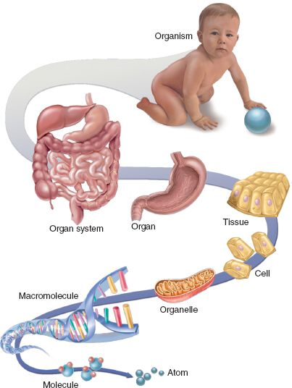
Cellular Hierarchy

Slide 27
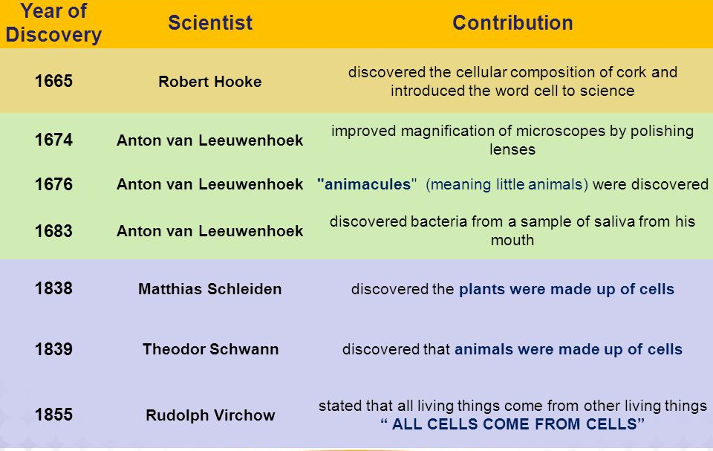
Time line of Cell Theory

Slide 28
Cell theory - Significance
The structural and functional relationship among the diverse living forms from bacteria to man
All cells irrespective of their function and position have a nucleus embedded in the cytoplasm and bounded by cell membrane (unity in their structural plan)
Same metabolic processes occur in all the cells primitive or specialized (unity of function)
This implies that all the living things have originated from the same primitive ancestral types that originated 2-3 billion years ago

Slide 29
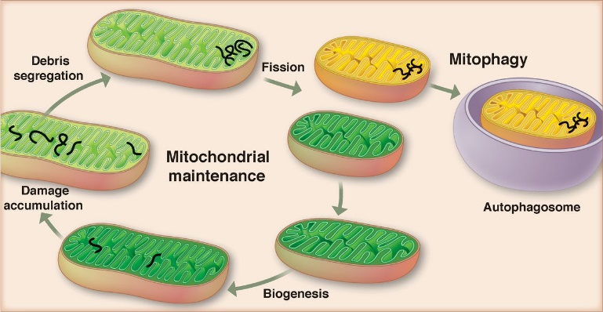
Cell theory – Exception
Viruses are the exception to cell theory because they are made up of proteins and one of the nucleic acid (DNA or RNA), lack protoplasm.
The first cell did not come from another cell
Mitochondria and chloroplast have their own genetic material and can reproduce independently

Slide 30
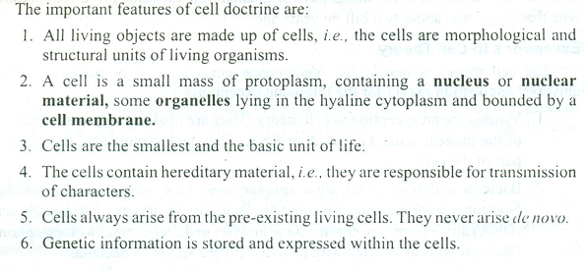
Cell theory and its improved understanding

Slide 31
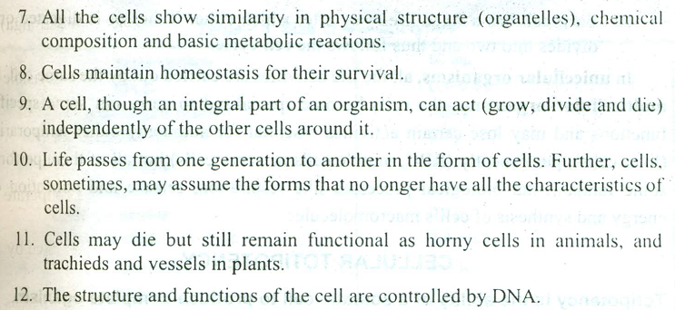
Cell theory and its improved understanding

